Slide 1
Building the business migration case with Windows Server and SQL Server
August 2022

Slide 2
Abstract and learning objectives
In this whiteboard design session, you will look at how to design for converting/extending an existing IaaS deployment for resiliency. Throughout the whiteboard design session, you will look at the various configuration options and services to help build resilient architectures.
At the end of the workshop, you will be better able to design and use resiliency concepts including high availability with Availability Zones, disaster recovery for virtual machines to another region using Azure Site Recovery, and SQL Server high availability and disaster recovery using AlwaysOn Availability Groups. You will also learn how to assess the availability SLA, RPO and RTO of your design, and how to use Azure Backup to protect and secure your SQL data and VMs against corruption and loss.
You will also discuss how to achieve a similar level of resiliency for a PaaS-based implementation the same application, based on Azure App Service and Azure SQL Database. Finally, you will consider the costs associated with both approaches.

Slide 3
Step 1: Review the customer case study
Outcome
Analyze your customer needs.
Timeframe
15 minutes

Slide 4
Customer situation
?
?
?

Slide 5
Customer situation - continued
?
?
?

Slide 6
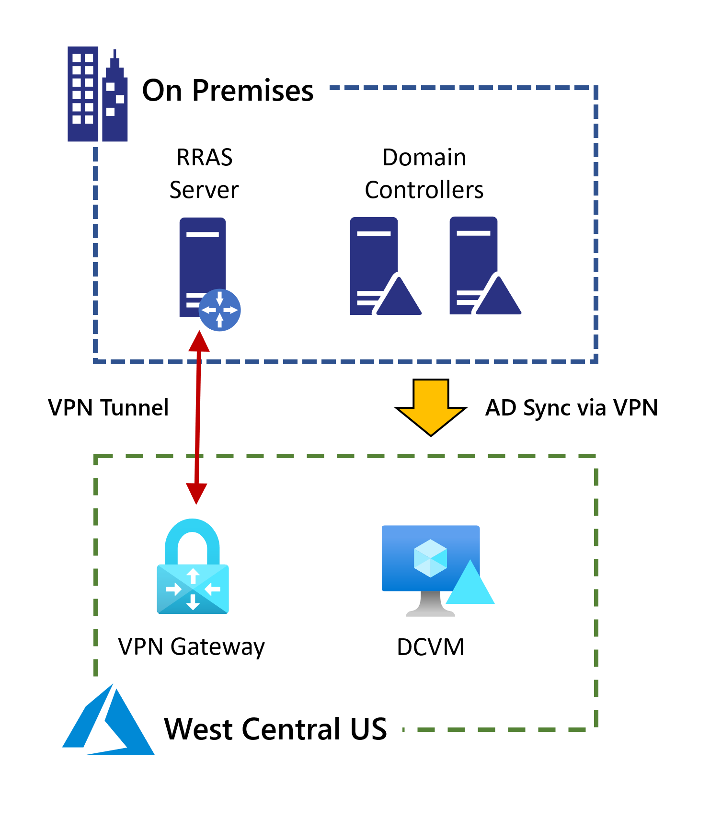
Current Active Directory Configuration
Currently have a single domain controller deployed in west central US
Connectivity is enabled with a site-to-site VPN gateway

Slide 7
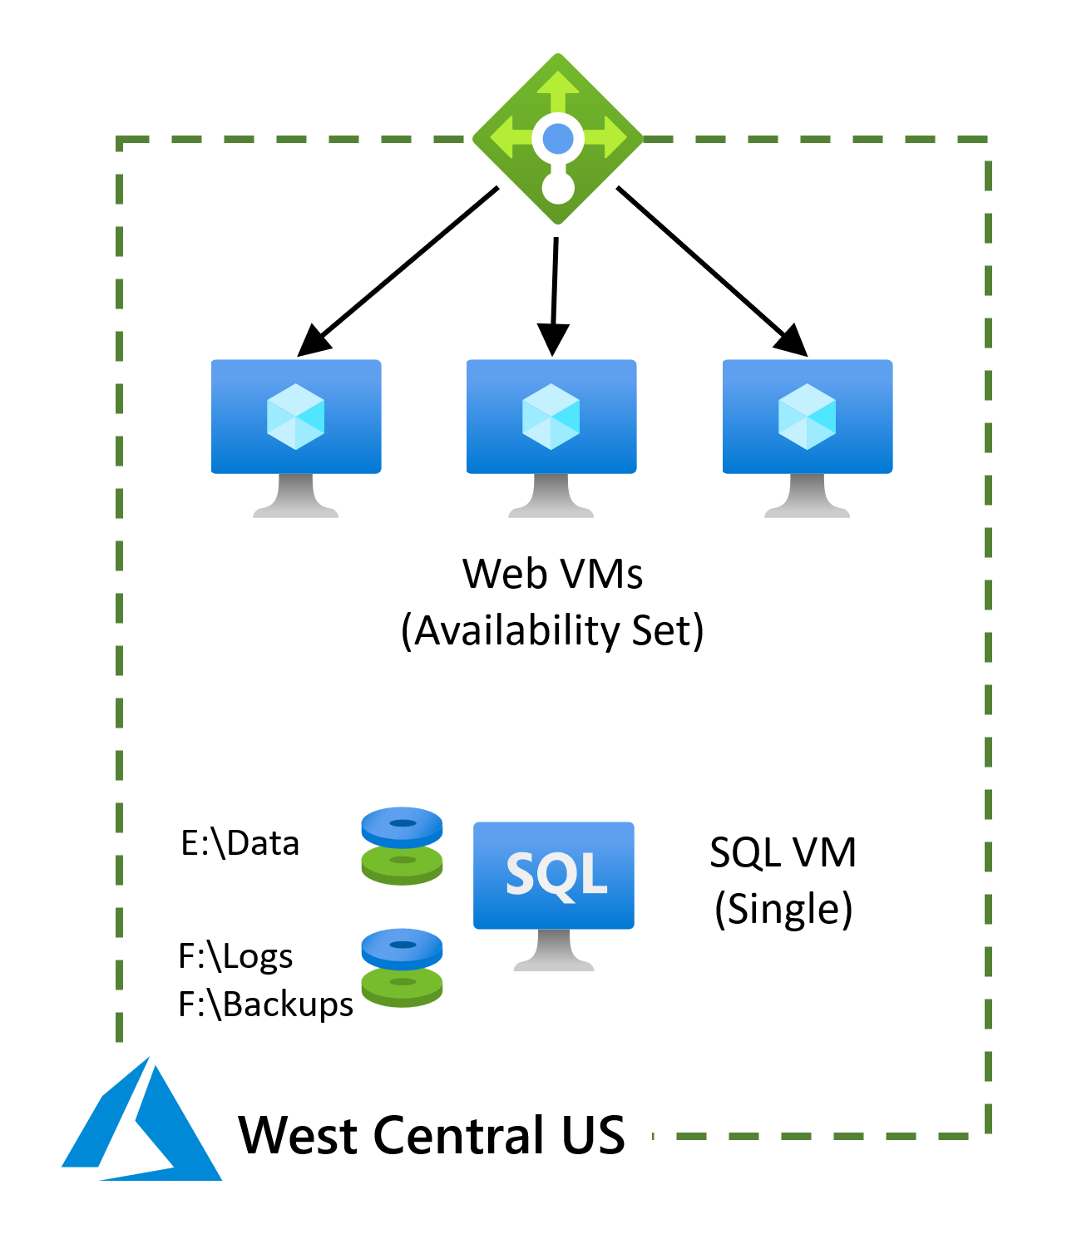
Current configuration for claims application
Web servers deployed into an availability set
SQL Server backend (single VM)
West Central US

Slide 8
Customer needs
?
?
?

Slide 9
Customer needs - continued
?
?
?
Contoso also want to fully understand the costs associated with each of 1 – 6 above.

Slide 10
Customer objections
?
?
?

Slide 11
Common scenarios

Slide 12
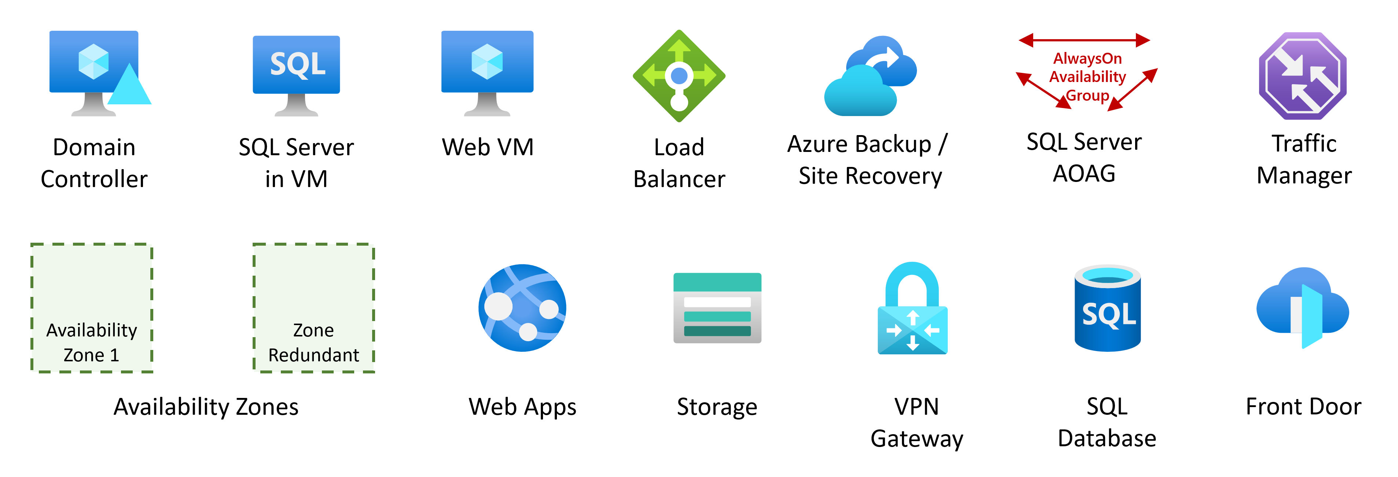
Common scenarios

Slide 13
Step 2: Design the solution
Outcome
Design a solution and prepare to present the solution to the target customer audience in a 15-minute chalk-talk format.
Timeframe
1-2 hours
Business needs | Respond to questions outlined in your student guide and be prepared to present your solution to others.
Design | Design a solution for as many of the requirements in your student guide as time allows.
Pricing | Provide an estimate of the costs associated with each aspect of your solution, following the questions in your student guide.
Prepare | Identify any customer needs that are not addressed with the proposed solution. Identify the benefits of your solution. Determine how you will respond to the customer’s objections. Prepare for a 15-minute presentation to the customer.

Slide 14
Step 3: Present the solution
Outcome
Present a solution to the target customer in a 15-minute chalk-talk format.
Timeframe
30 minutes (15 minutes for each team to present and receive feedback)
Directions
Pair with another team.
One group is the Microsoft team and the other is the customer.
The Microsoft team presents their proposed solution to the customer.
The customer asks one of the objections from the list of objections in the case study.
The Microsoft team responds to the objection.
The customer team gives feedback to the Microsoft team.
Switch roles and repeat Steps 2-6.

Slide 15
Wrap-up
Outcome
Review the preferred solution for the case study.
Timeframe
15 minutes

Slide 16
Preferred target audience
Kaylee Frye, CTO
?, Role
?, Role
?, Role

Slide 17
Solution Outcome 1
?
?
?

Slide 18
Solution Outcome 2
?
?
?

Slide 19
Customer objections
Objection
?
Potential answer
?
?

Slide 20
Customer quote
“?”
— Kaylee Frye, CTO, Tailspin Toys

